Slide 1

Michael Harper
Misael Obregon
Richard Harris
Project 1 – FBI Background Checks & Mass Shootings

Slide 2
The “Ask”
Do mass shootings cause an increase in the number of firearm permit applications?
Mass Shootings
Defined in this analysis as a firearm-related incident involving four or more fatalities typically simultaneously or over a short period of time and in close geographic proximity.
Firearm Permit Applications
Defined in this analysis as initial applications not rechecks or renewals.
State background checks are not included.

Slide 3


Data Sources
The FBIs National Instant Criminal Background Checks System (NICS). The FBI provides the number of firearm checks by month, state, and type. This data covers the period November 1998 thru June 2019.
The mass shooting database comes from the Mother Jones magazine investigation. The data covers the years 1982 thru 2019. For purposes of this analysis, the data was aligned with the background check dataset excluding all incidents prior to November 1998.

Slide 4
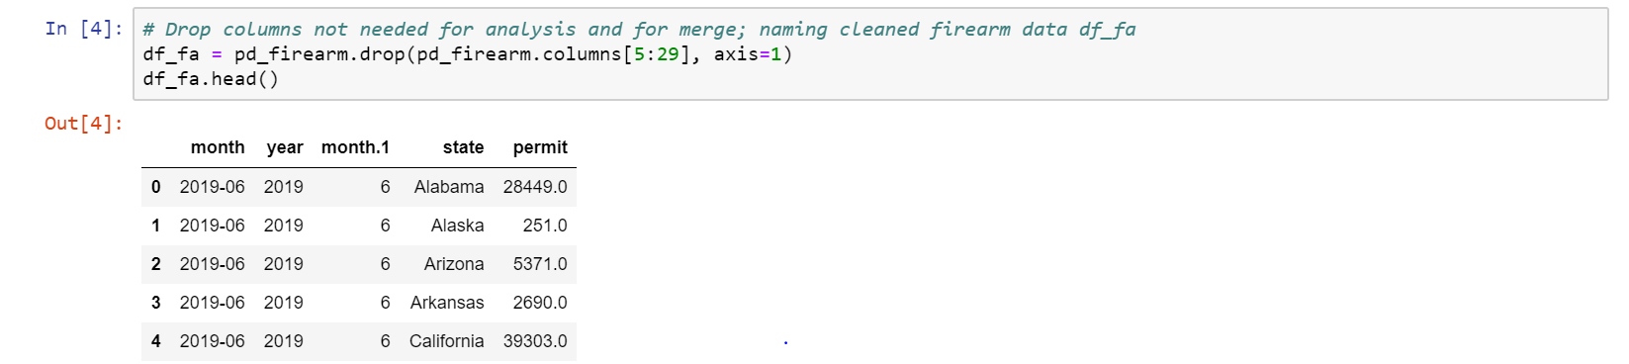
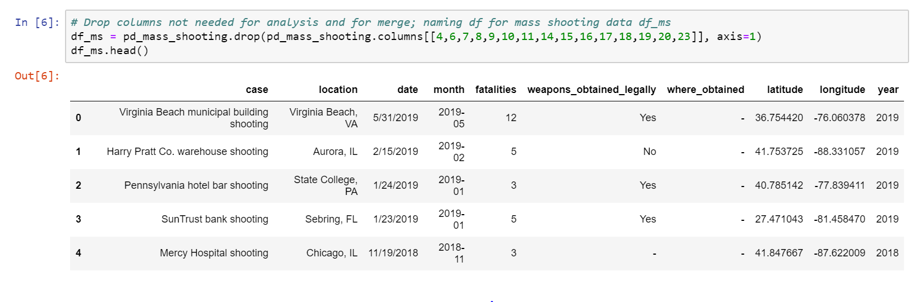
Assemble and Clean – Individual Datasets
Firearm Permit Application Data
Mass Shooting Data

Slide 5
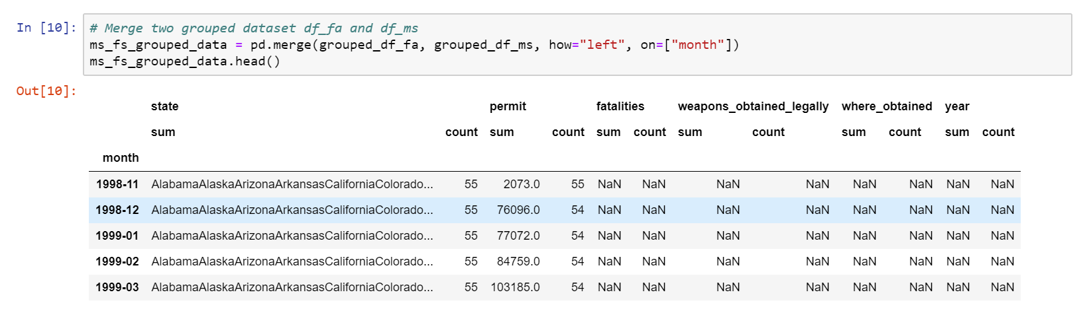
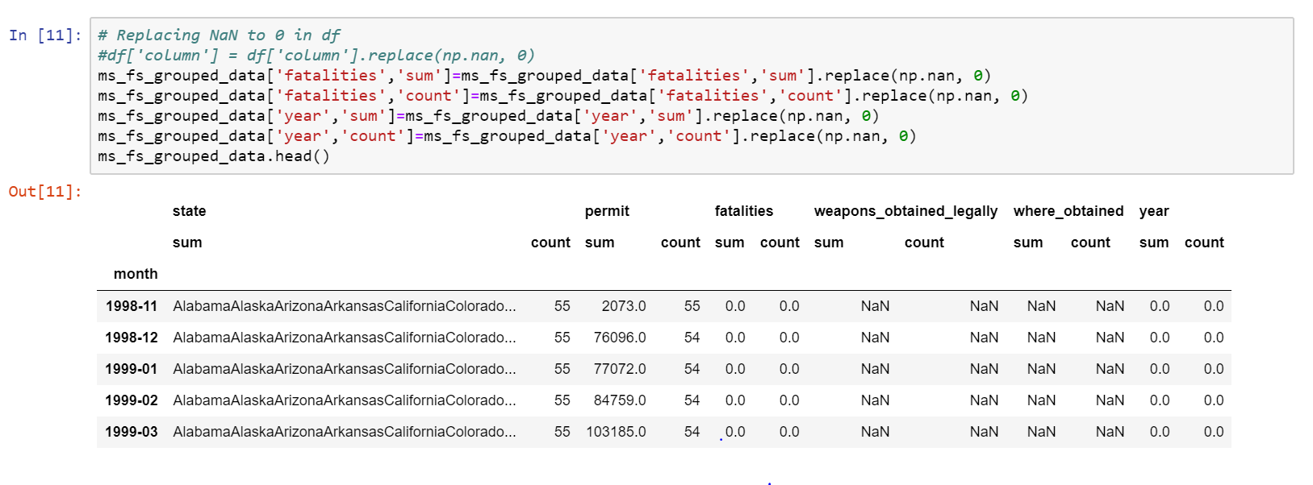
Assemble and Clean – Merged Dataset
Merged
Datasets
Replace
NaNs

Slide 6
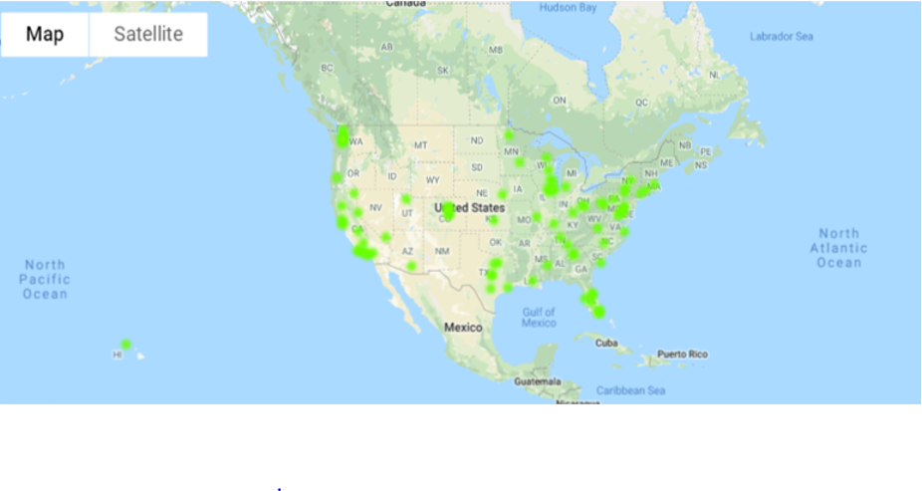
Heat Map of Mass Shootings
Green Dots represent Mass Shooting incidents

Slide 7
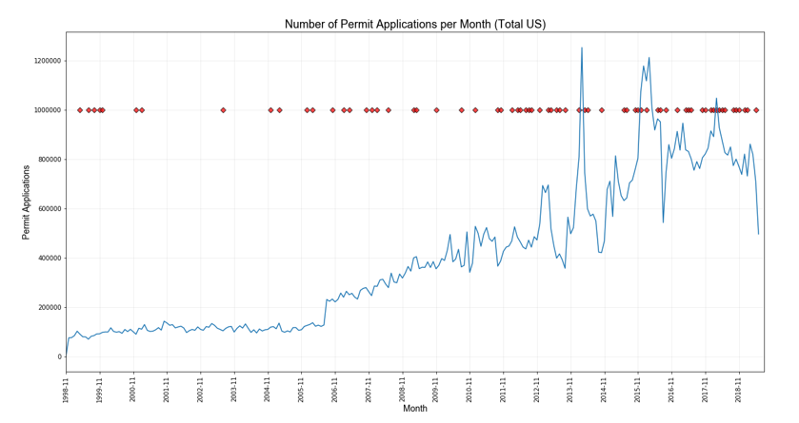
US Permit Applications & Mass Shootings
Shootings occurred
in Oct15, Nov15,
Dec15, and two in
Feb16
According to NSSF,
NC had a spike in
apps due to CCW
NSSF – National Shooting Sports Foundation
CCW – Concealed Carry Weapon permits

Slide 8
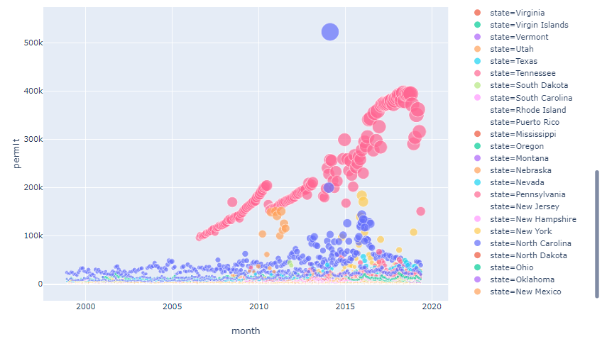

Permit Applications By State
rNorth Carolina
The red dots represent
Kentucky, who send ALL
checks thru FBI due to not
having state mechanism

Slide 9
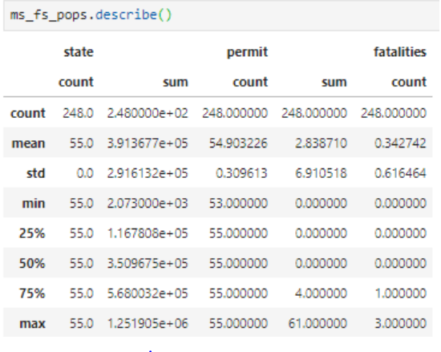
Descriptive Statistics of Merged Data

Slide 10
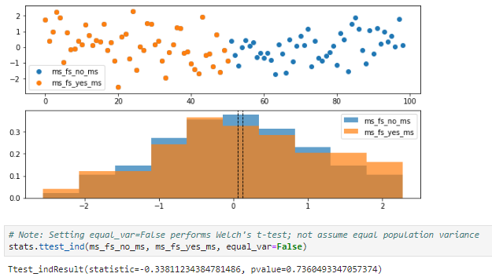
Scatter Plot/Histogram of Subpopulations

Slide 11
Limitations of Analysis
We know little about gun violence and its prevention compared to other
safety and health threats, because the federal government has not had
a comprehensive program of research.
Additional, high-quality research is needed to craft policies that could
contribute to reducing gun injuries, deaths, and violence.
There are many ways Congress could help build a robust and transformative
gun policy research enterprise.
States have different laws regarding background applications.
Our data only includes FBI background not state background resources.
In many states, private sellers are not required to do background checks
prior to the sale.
Name of the study and Author: Reducing Disagreements on Gun Policy Through Scientific Research and an Improved Data Infrastructure Andrew R. Morral

Slide 12
Hypothesis Testing
Research question: Do mass shootings increase the number of gun permit
applications?
Hypothesis: Mass shootings increase the number of gun permit applications
Findings: Data shows that there is no significant difference in increase in gun
permit applications as a result of a mass shooting. Thus, we accept the null
hypothesis.

